Slide 1
Brain Tumor Classification With Deep Convolutional Neural Networks
CSC 630 – Independent Study
Aman Chauhan

Slide 2
Contents
Datasets
Design
Human Interpretable Explanations
Approach
Building Blocks
Model Selection
Regularization
Architecture
Fine Tuning
Libraries

Slide 3
Data sets
Open Dataset and Stanford Dataset

Slide 4
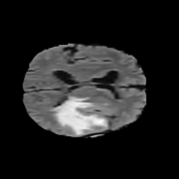
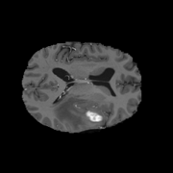
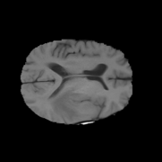
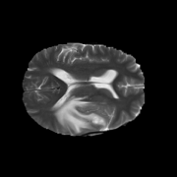
Open Dataset – Grand Challenge Brain Tumor Segmentation
FLAIR
T1GD
T1W
T2W

Slide 5
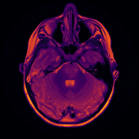
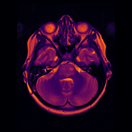
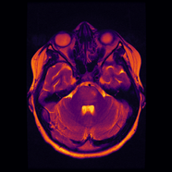
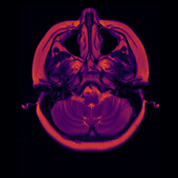
Stanford Dataset

Slide 6
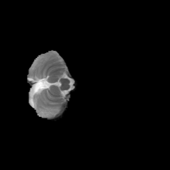

Normalization
Per Plane based
Training based

Slide 7
Design
A look at the different components of Autoencoder and various Publicly available models used for Transfer Learning

Slide 8
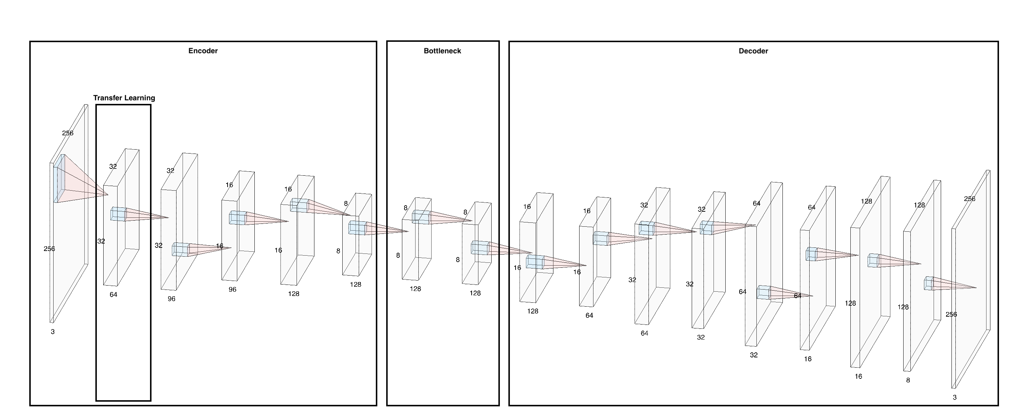
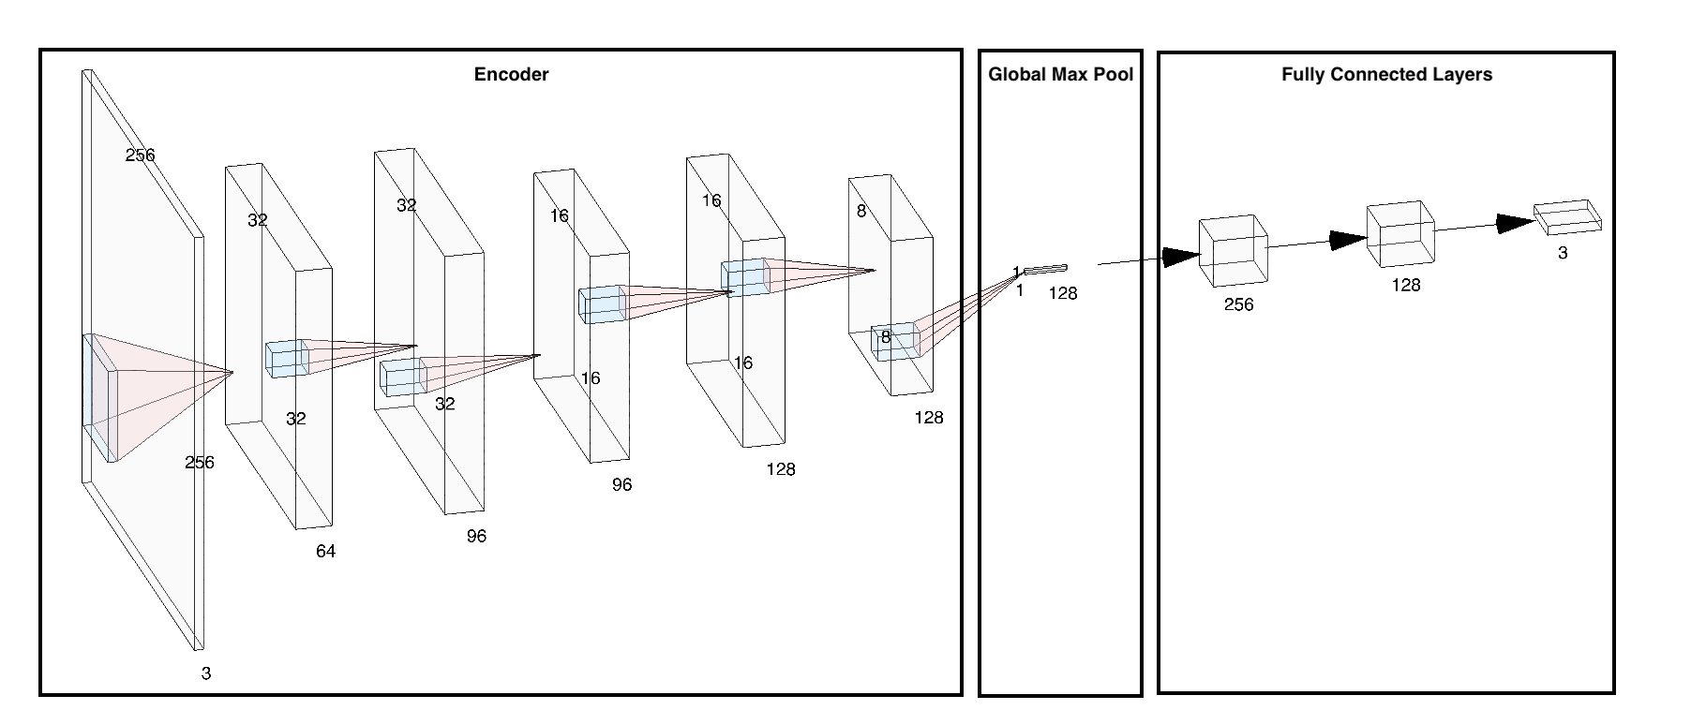
Overview
Autoencoder
Classifier

Slide 9
Autoencoder
Parameters
size - size of the input image and expected output image
resnet_layers - number of layers we want from Public Layers
top_filters - number of filters we want on top of Public layers
reduction_layers - number of layers we want to add in front of Public Layers
neck_layers - number of layers we want in the Bottleneck

Slide 10
Encoder

Slide 11
BottleNeck

Slide 12
Decoder

Slide 13
Classifier
Parameters
resnet_layers – number of layers we want from Public Layers
top_filters – number of filters we want on top of Public layers
reduction_layers – number of layers we want to add in front of Public Layers
neurons – number of neurons in hidden layers
dropout – dropout rate in fully connected layers

Slide 14
Classifier

Slide 15
Human Interpretable Explanations
A look into what kind of features the Public Networks learn

Slide 16
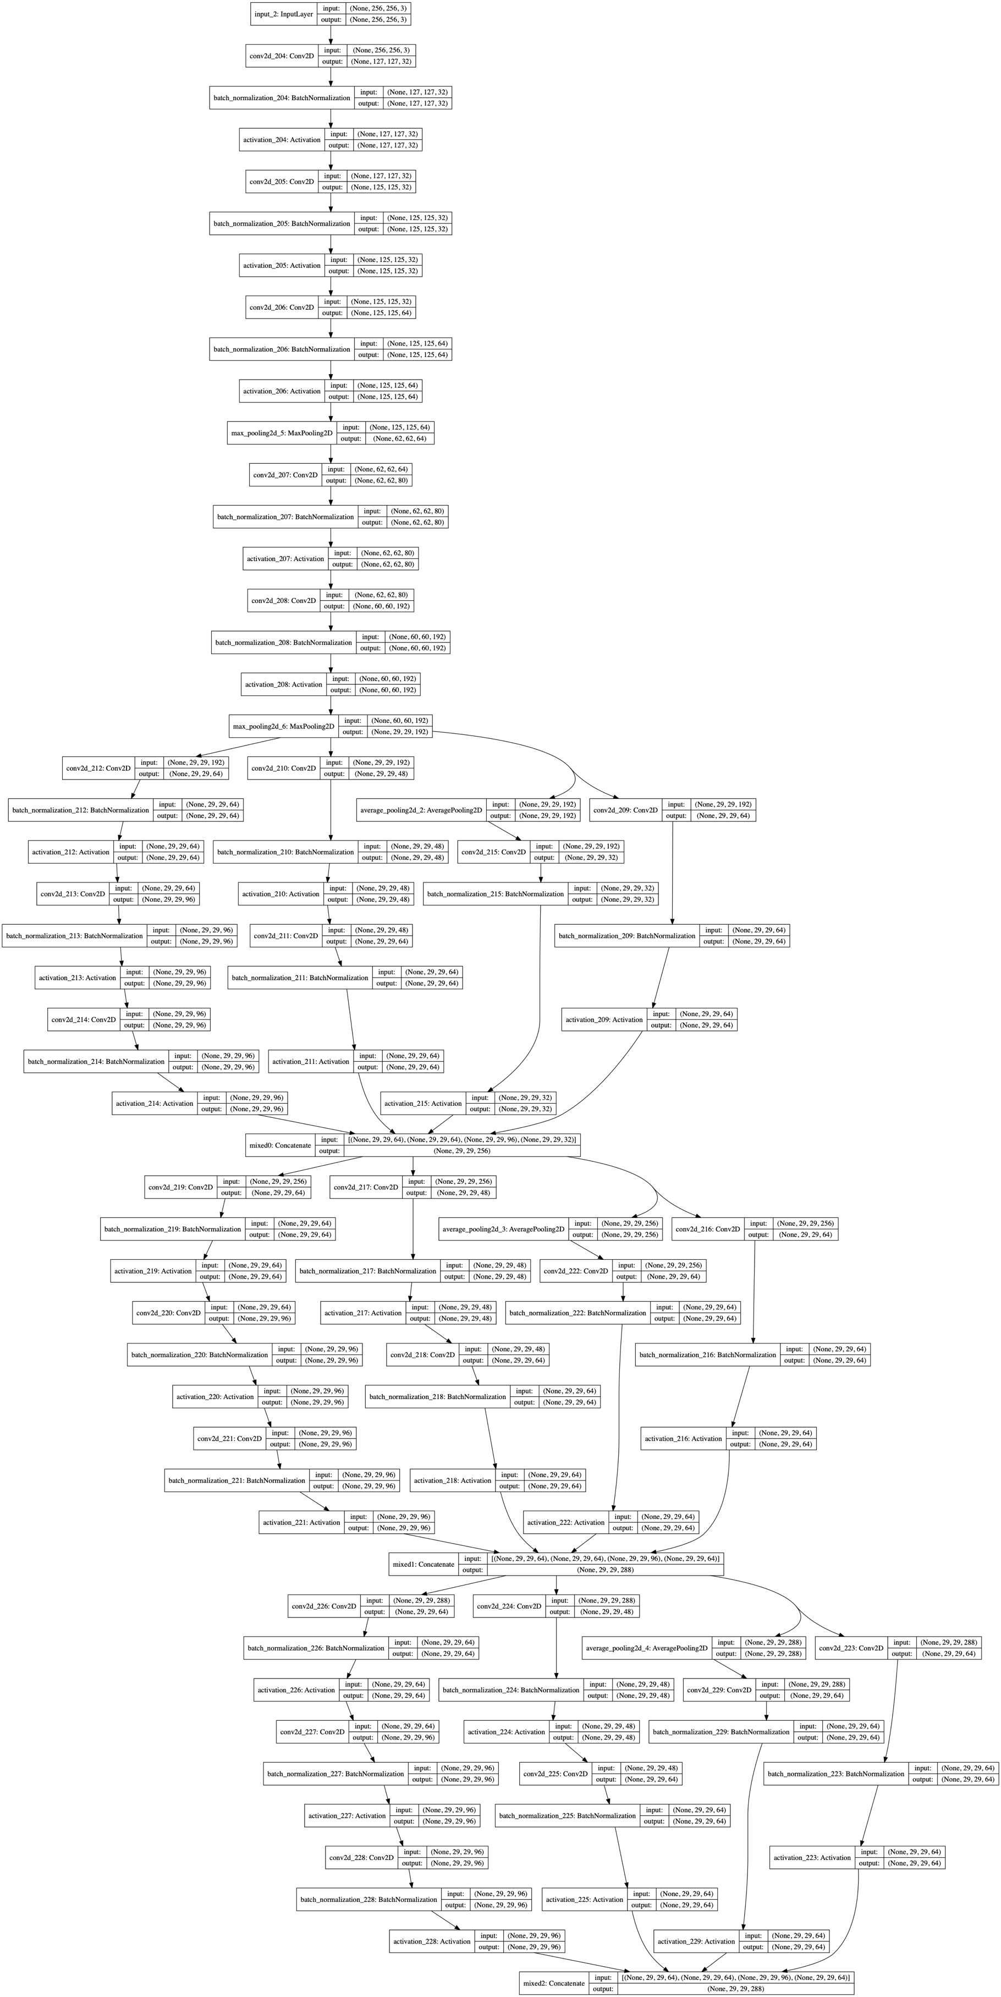
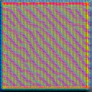
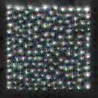
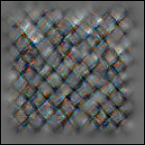
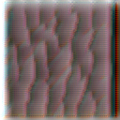
Inception-v3

Slide 17
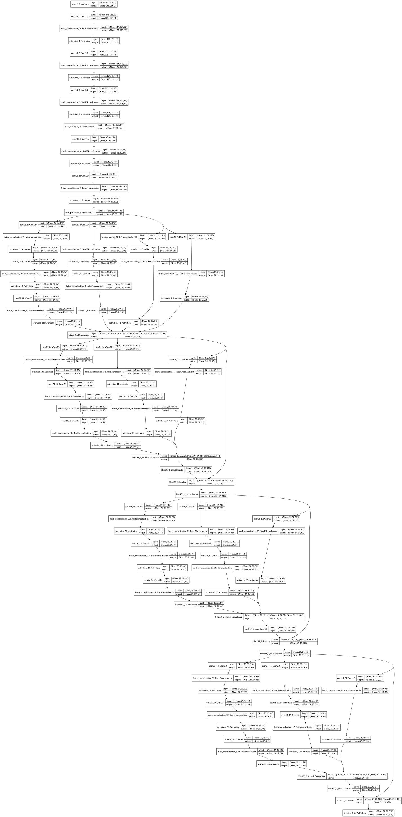
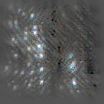
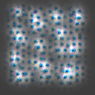
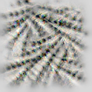
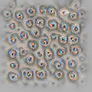
Inception-ResNet-v2

Slide 18
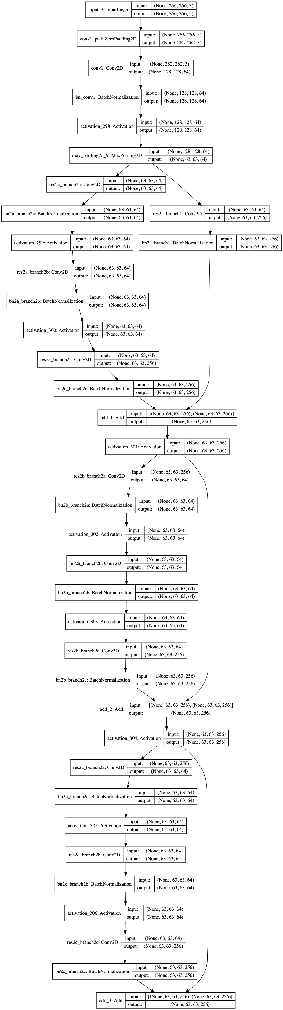
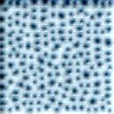
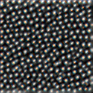
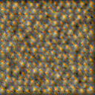

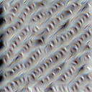

ResNet-50

Slide 19
Selection
ResNet produced more visually similar representation of the actual brain, compared to Inception-v3 and Inception-ResNet-v2.
Notion is – The better the recreation, the more critical features the encoder is learning.
Risk – The recreation might be influenced by the decoder.

Slide 20
Approach
Pretrain and Finetune the Autoencoder to learn brain features using the Public Dataset, and then adjust those weights with classification task on the Stanford dataset

Slide 21
Building Blocks
Convolution Layers, Batch-Normalization Layers, MaxPooling Layers, Upscaling Layers, Global MaxPooling Layers, Fully-Connected Layers

Slide 22
Regularization
Batch-Normalization and Dropout

Slide 23
model selection

Slide 24
Model Selection
Autoencoder – 72% train, 8% validation, 20% test
Classifier – 90% train, 10% test
resnet_layers
top_filters
reduction_layers
neck_layers
neurons
dropout

Slide 25
Model Selection
All models were trained till 100 epochs.
EarlyStopping was used to monitor the training, and stop once the validation loss doesn’t improve in 5 turns.
Model Checkpoint was used to save the model every time there was an improvement in the validation loss.

Slide 26
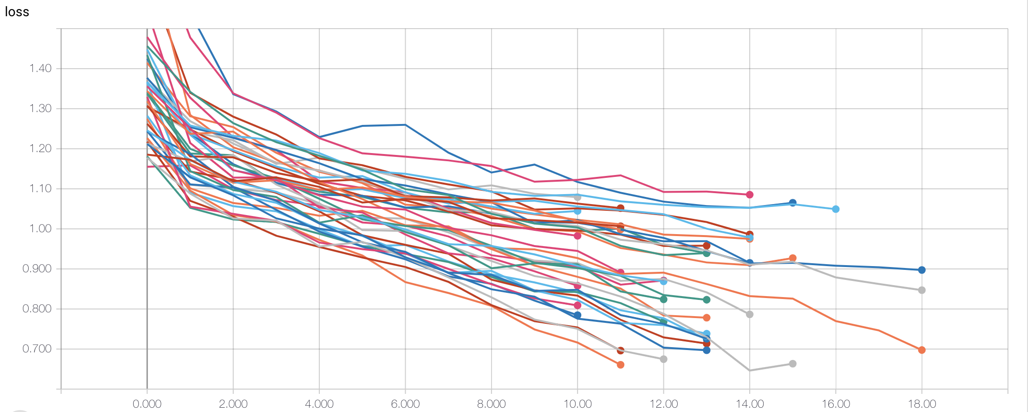
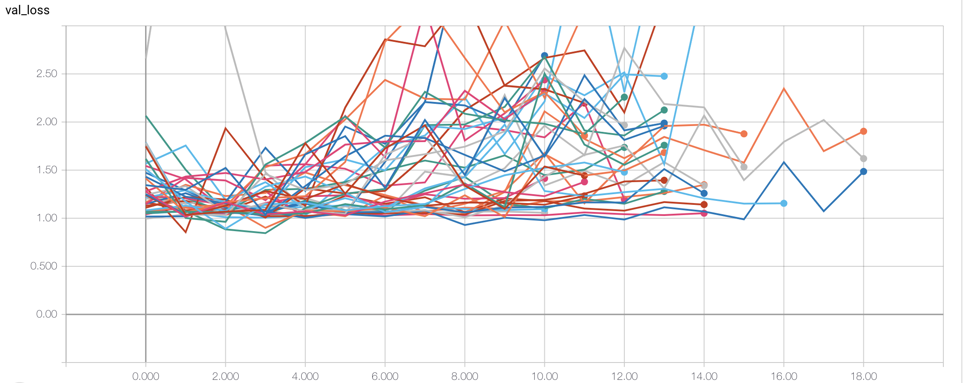
Model Selection

Slide 27
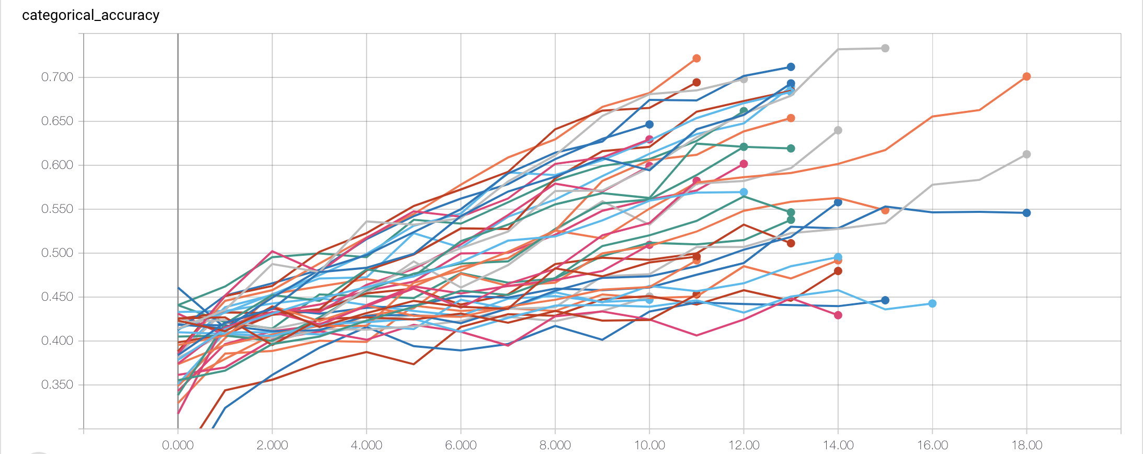
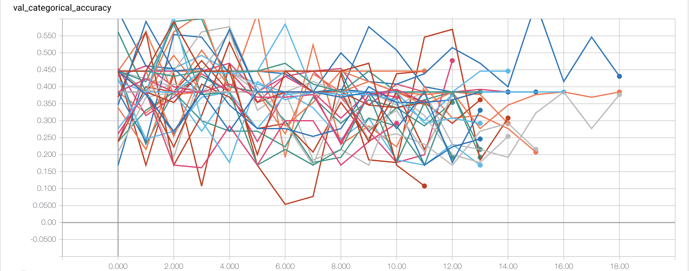
Model Selection

Slide 28
Environment
The work environment used to develop this project

Slide 29
Work Environment
Tensorflow GPU – 1.4.0
Keras Applications – 1.0.8
Keras – 2.1.5
Python 2.7
ImageIO
Scikit-Learn
Numpy
Pydicom
Nibabel

Slide 30
Keras graphs
A look into 1 of the best model

Slide 31
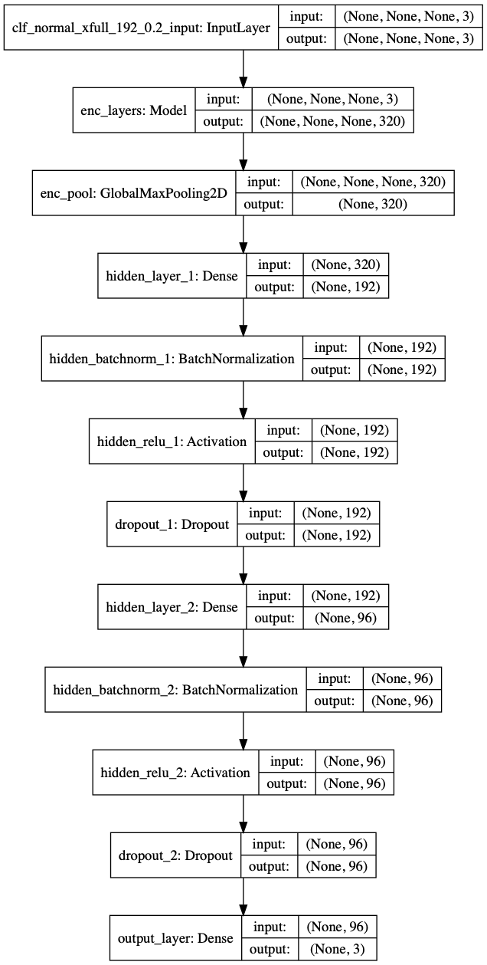
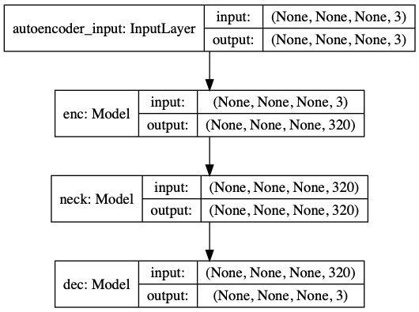
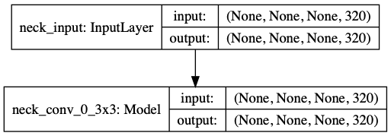
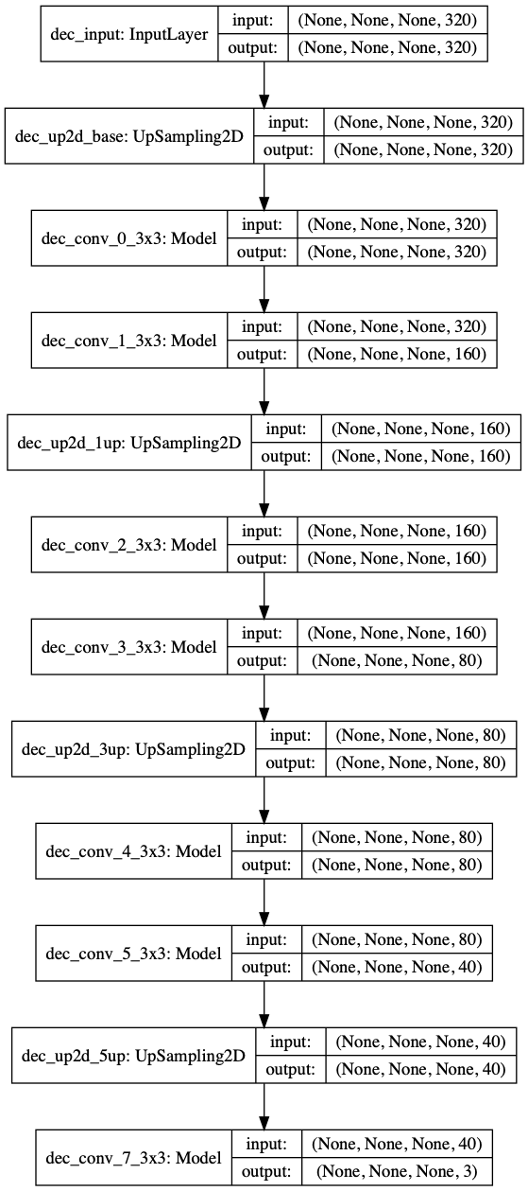
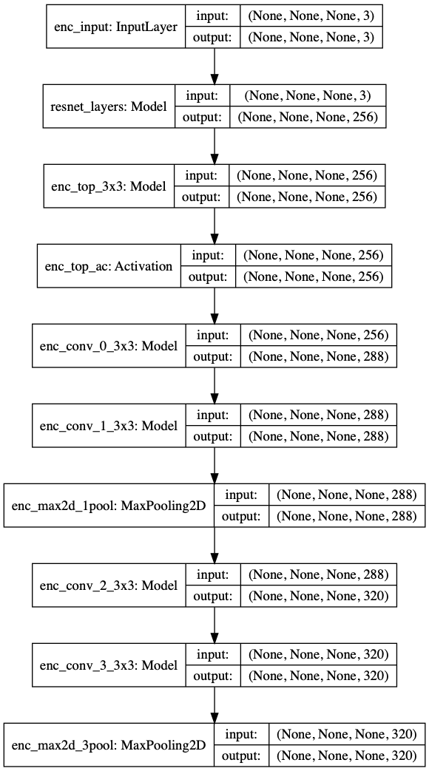
AutoEncoder
Bottleneck
Classifier
Decoder
Encoder

Slide 32
Results

Slide 33
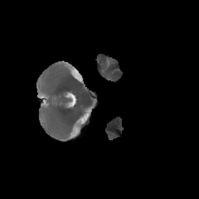
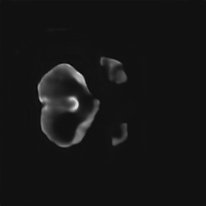
Autoencoder – Per Plane
Original
Recreation

Slide 34

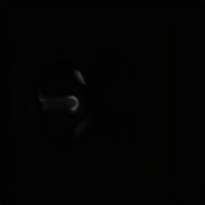
Autoencoder - Normal
Original
Recreation

Slide 35
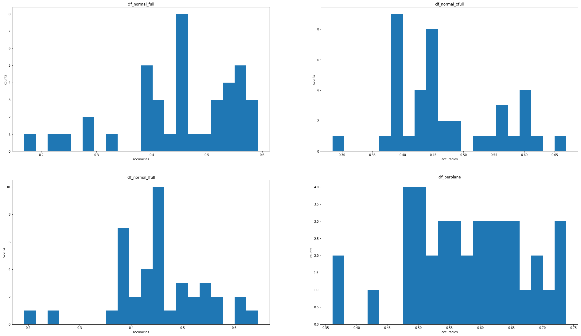
Accuracy of Various Models

Slide 36
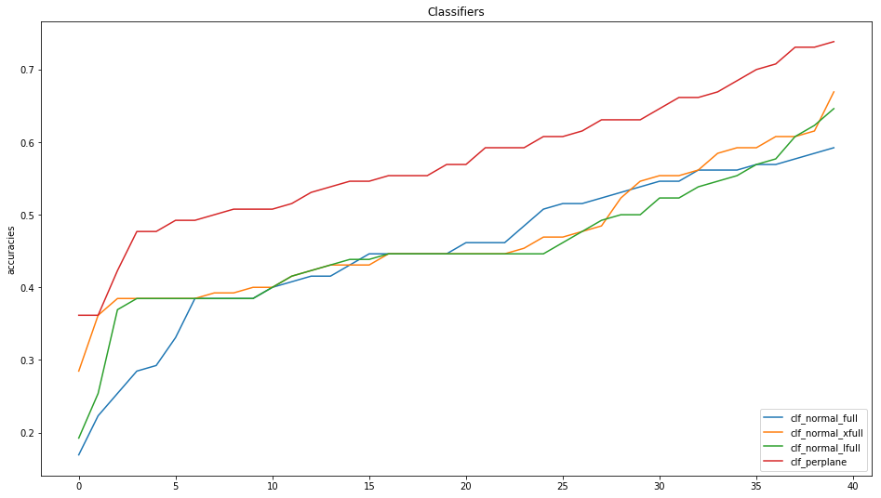
Accuracy of Various Models

Slide 37
What doesn’t work
Images – MRI scans are not to be considered as traditional RGB images. These are continuous intensity values, whose range is dependent on the machine being used to scan the brains. Converting them into RGB images means
We are reducing the range to 0-255
Quantizing the values, which leads to loss of information
Normalization – Simple training set normalization seems to remove a lot of contrast from the images. We need to do something in the following in order –
Normalize the scans based on the machine intensity
Normalize the planes on a per patient (whole brain/affected planes) basis
Normalize the planes in the train on patient basis

Slide 38
Thank you

